Slide 1

EDA Project on Credit Card Customer’s Churn Analysis by Wale SOLUADE

Slide 2

BUSINESS PROBLEM
A Business manager of a consumer credit card portfolio at the bank is disturbed with more and more customers leaving their credit card services. They are facing the problem of customer attrition and would really appreciate if one could predict for them who is gonna get churned so they can proactively go to the customer to provide them better services and turn customers' decisions in the opposite direction.
It was noted that Majority of the customers are females, graduates, aged between 40-50,married, have at least 3 dependents and earn less than $40k
We have only 16.07% of customers who have churned. Thus, it's a bit difficult to train our model to predict churning customers.

Slide 3
THE DATASET and insights
Observation: The data is mostly clean and no duplicate or missing values.
This dataset used for this project consists of 10,000 customers mentioning their age, salary, marital status, credit card limit, credit card category, etc. There are nearly 18 features.
The Bank has 10,127 customers out of which 1,627 are attritted (16.07%)
Platinum card holders have the highest percentage of attrition (25%) and the lowest number of customers
Months on book and customer age are correlated(0.79) just as transaction amt and transaction count are correlated(0.81)
Most attritted customers are youth and most of them have been with the company for at least 30 months
Majority of the customers are females, graduates, aged between 40-50,married, have at least 3 dependents and earn less than $40k

Slide 4
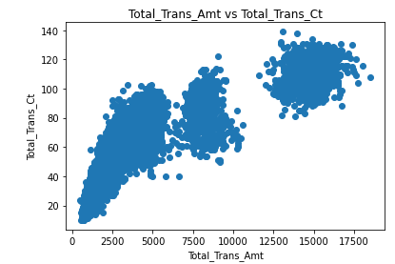
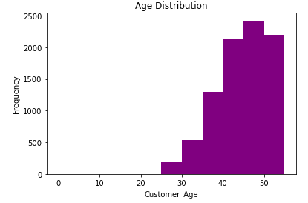
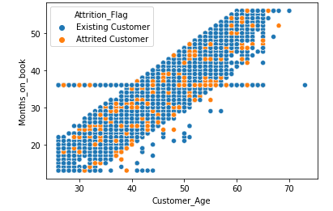
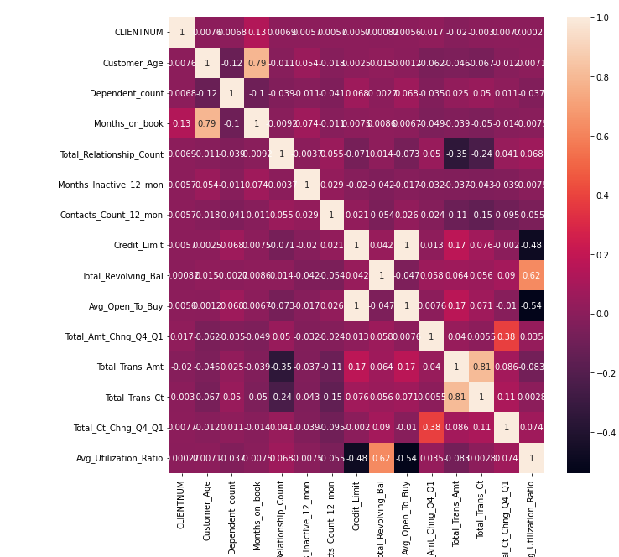
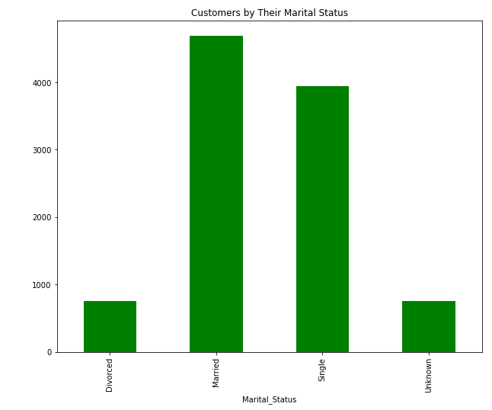
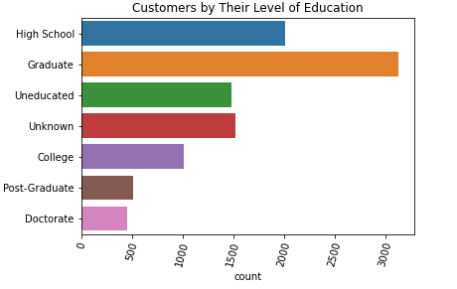
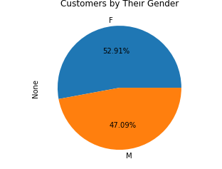
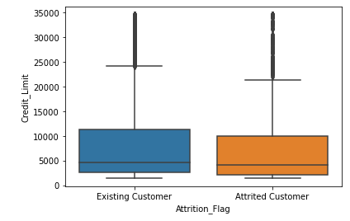
GRAPHICAL ANALYSIS AND REPRESENTATION

Slide 5


